Slide 1


Pulp, Paper and Lumber Trading
Report Date - July, 2000
Confidential

Slide 2
Pulp, Paper and Lumber Trading
Project Objective:
Our review was designed to identify and test key policies, procedures and controls as of March 31, 2000 related to 1) Pulp, paper and lumber mid and back office operations 2) Relationship and coordination between the commercial, risk, credit, accounting, legal, confirmation and settlements groups involving pulp, paper and lumber and 3) Scheduling of pulp, paper and lumber movement and related controls (where applicable).
AA Team Members: Enron Team Members:
Tom Bauer Scott Earnest
Jennifer Stevenson Gordon Heaney
Sean Kiehne John Jacobsen Dana Carr Lisa Berg-Carver
Mark Austin Robert Richard
Charlie Hoang Cheryl Kaiser
Jarrod Cyprow

Slide 3
Pulp, Paper and Lumber Trading - Current Portfolio
Environment
  Trading activity in Houston and London
  Origination activity in Calgary
  Risk Management operations performed in Houston for all trading activity
  Pulp, paper and lumber markets are relatively illiquid
  On average, 1-2 transactions per day
  ClickPaper expected to significantly increase number of pulp, paper and lumber transactions
  Commercial personnel very receptive to importance of the credit department
  ClickPaper will require Enron to physically schedule commodity movement

Slide 4
Pulp, Paper and Lumber Trading - Current Portfolio
Portfolio
Financial
Large portion of deals with Waste Management and Georgia Pacific
MTM value primarily from financial transactions (approx. 80% of MTM value as of 3/31/00)
Small amount of financial lumber trades
Physical
Spot physical transactions are generally back-to-back deals
Primarily prompt month trading
Transport mechanisms include rail, barge and truck
Spot physical counterparties generally have low E-ratings
  * DEAL TEST- 17 Financial - 3 Physical

Slide 5
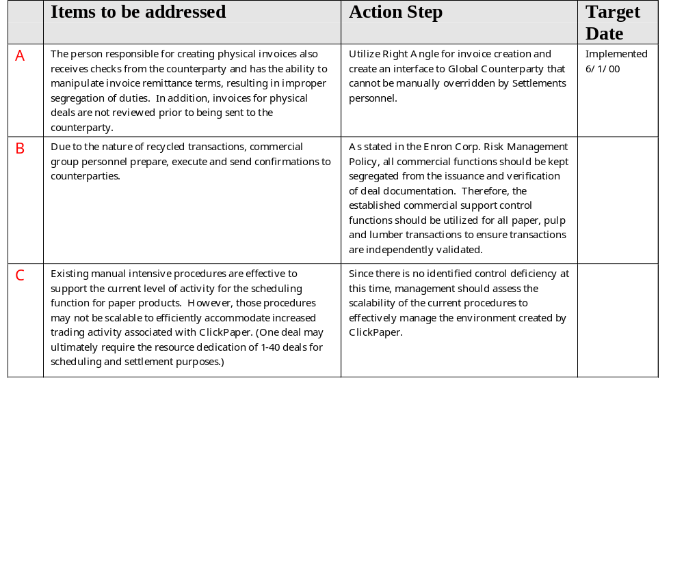
Pulp, Paper and Lumber Trading - Observations

